Slide 1
Symmetric and Distributed Shared Memory Architectures

Slide 2
Importance of Multiprocessing
The dramatically lower efficiencies in silicon and energy use that were encountered between 2000 and 2005 as designers attempted to find and exploit more ILP, which turned out to be inefficient, since power and silicon costs grew faster than performance.
Other than ILP, the only scalable and general-purpose way we know how to increase performance faster than the basic technology allows (from a switching perspective) is through multiprocessing.
A growing interest in high-end servers as cloud computing and software-as a-service become more important.
A growth in data-intensive applications driven by the availability of massive amounts of data on the Internet.

Slide 3
The insight that increasing performance on the desktop is less important (outside of graphics, at least), either because current performance is acceptable or because highly compute- and data-intensive applications are being done in the cloud.
An improved understanding of how to use multiprocessors effectively, especially in server environments where there is significant natural parallelism, arising from large datasets.
The advantages of leveraging a design investment by replication rather than unique design; all multiprocessor designs provide such leverage

Slide 4
Multiprocessors
Multiprocessors – Computers consisting of tightly coupled processors whose coordination and usage are typically controlled by a single operating system and that share memory through a shared address space.
Exploits thread level parallelism by executing tightly coupled set of threads collaborating on a single task called parallel processing.
Exploits request level parallelism : processes originate from more than one users
Request-level parallelism may be exploited by a single application running on multiple processors, such as a database responding to queries, or multiple applications running independently, often called multiprogramming.

Slide 5
Issues and Approach
To take advantage of an MIMD multiprocessor with n processors, we must usually have at least n threads or processes to execute.
The independent threads within a single process are typically identified by the programmer or created by the operating system (from multiple independent requests).
A thread may consist of a few tens of iterations of a loop, generated by a parallel compiler exploiting data parallelism in the loop.
The amount of computation assigned to a thread is called the grain size. Grain size must be sufficiently large to exploit the parallelism efficiently.

Slide 6
Types of shared-memory multiprocessors
symmetric (shared-memory) multiprocessors (SMPs) or centralized shared-memory multiprocessors
  share a single centralized memory that all processors have equal access to, hence the term symmetric
  SMP architectures are also sometimes called Uniform Memory Access (UMA) multiprocessors, since all processors have uniform latency from memory

Slide 7
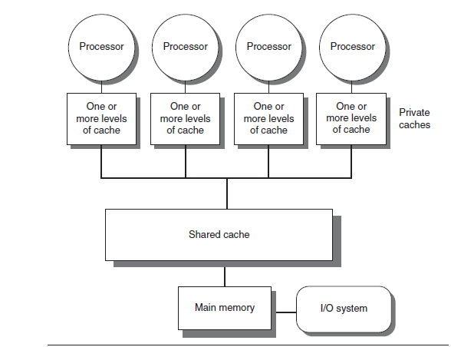
Basic structure of a centralized shared-memory multiprocessor

Slide 8
Distributed Shared memory architecture
To support larger processor counts, memory must be distributed among the processors rather than centralized.

Slide 9
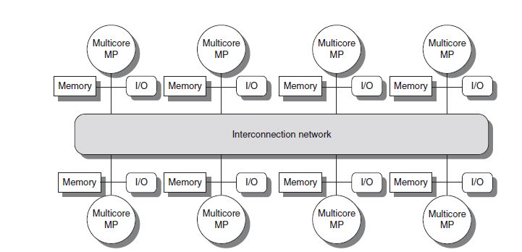
Basic architecture of a distributed-memory multiprocessor

Slide 10
Distributed-memory multiprocessor
Distributing the memory among the nodes both increases the bandwidth and reduces the latency to local memory.
A DSM multiprocessor is also called a NUMA (non-uniform memory access), since the access time depends on the location of a data word in memory.
The key disadvantages for a DSM are that communicating data among processors becomes somewhat more complex, and a DSM requires more effort in the software to take advantage of the increased memory bandwidth afforded by distributed memories
The larger number of processors also raises the need for a high bandwidth interconnect

Slide 11
SMP and DSM
In both SMP and DSM architectures, communication among threads occurs through a shared address space.
i.e., memory reference can be made by any processor to any memory location, assuming it has the correct access rights.
The term shared memory associated with both SMP and DSM refers to the fact that the address space is shared.
In contrast, the clusters and warehouse-scale look like individual computers connected by a network, and the memory of one processor cannot be accessed by another processor without the assistance of software protocols running on both processors.
In such designs, message-passing protocols are used to communicate data among processors.

Slide 12
Challenges of Parallel Processing
Achieve good speedups with the limited parallelism available in programs.
Relatively high cost of communications.

Slide 13
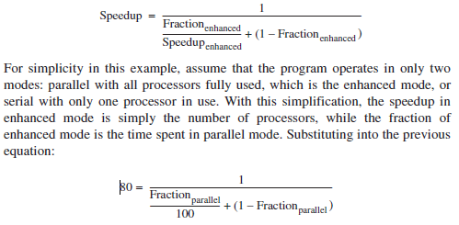
Suppose you want to achieve a speedup of 80 with 100 processors. What fraction of the original computation can be sequential?

Slide 14
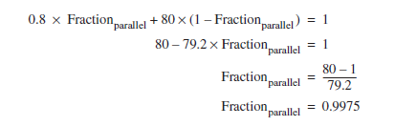
To achieve a speedup of 80 with 100 processors, only 0.25% of the original computation can be sequential.

